Slide 1
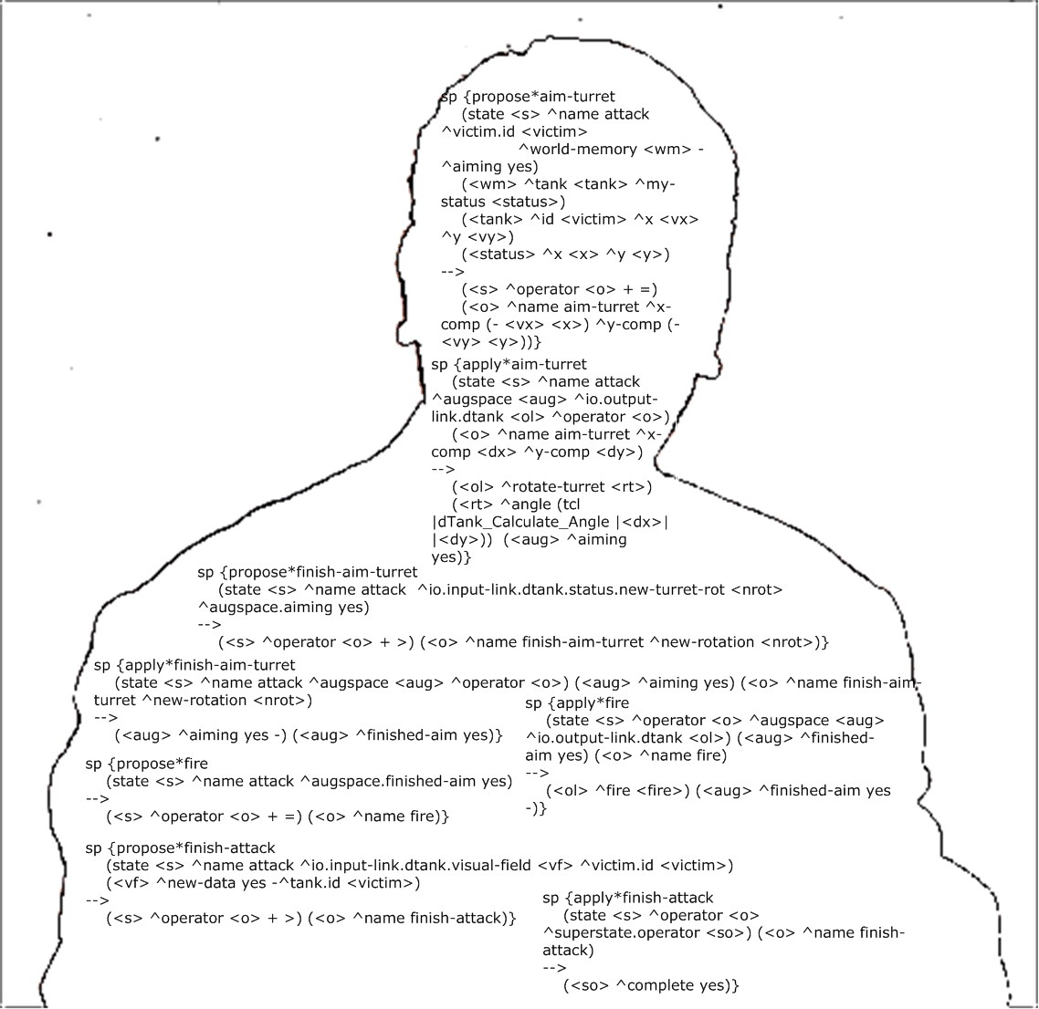
Herbal and the Herbal Viewer
Frank E. Ritter², Mark A. Cohen^{1,2}, Steve Haynes²,
Geoffrey P. Morgan²
1 BA CS & IT Department, Lock Haven University
2 School of IST, Penn State
acs.ist.psu.edu
This project was supported by the US Office of Naval Research, award number N000140210021. We also thank Urmila Kukreja, Isaac Councill, and the students of IST 402 the last two years for their work with and comments on Herbal.
The views expressed in this article do not necessarily reflect the positions or the policies of the U.S. Government, and no official endorsement should be inferred.

Slide 2
The Problem
(Ritter et al., 2003)
Overview
Cognitive architectures appear like assembly code
Explanation
Reuse
Ease of use
A high-level language that maps more directly to the domain the user is familiar with

Slide 3
Existing Solutions
Overview
Visual Soar
SoarDoc
ViSoar
G2A
All graphical IDEs, e.g., JACK, iGen, Cogent

Slide 4
Using a High Level Behavioral Representation Language
Design rationale anchors model explanations
( Haynes, 2001;  Haynes et al., 2004)
  Design knowledge capture during development
Model description needed for explanations ( Haynes, 2003)
  Create model parts within IDE
Responsibility-driven approach through a compiler
  Organize knowledge and rules
  ( Haynes et al., 2004;  St. Amant & Ritter, 2004, www4.ncsu.edu/~stamant/G2A)
Notes:
3x productivity from Yost’s thesis at cmu in 1990 with TAQL
Haynes 2002 is phd at London School of Economics

Slide 5
Herbal Design
Augment existing planning language with design rationale
  Chose PSCM, RDF, and Protégé : tool availability, generality
  Also studied direct translation ( St. Amant & Ritter, 2004)
  Ontology also helps structure
Explanation from declarative representation + rationale
Compile into Soar rules (XSLT)
  (could also compile into ACT-R, JACK ?)
Designed to leverage VISTA
  (declarative representation supports model tracing)
  acs.ist.psu.edu/vista for our local training examples

Slide 6
The Herbal Ontology
Programming in the Herbal high-level language involves instantiating objects using these ontological classes.
Programming a model is reduced to instantiating objects from a set of fixed classes, instead of coding the classes and structure implicitly in a large set of heterogeneous Soar productions.

Slide 7
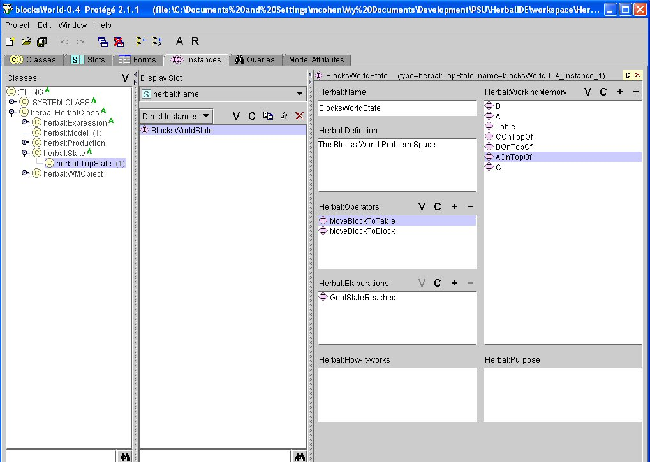
Herbal Integrated Development Environment (IDE) - Overview
Notes:
URL provides access to the tcl/tk compiler and to a version of the example here.

Slide 8
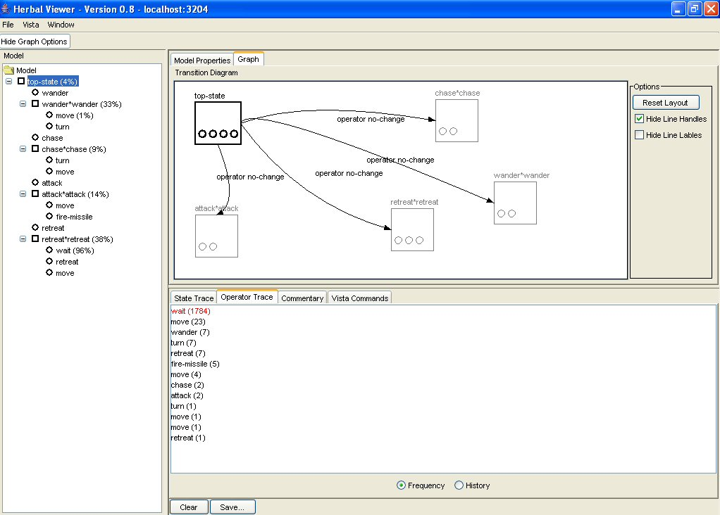
Support in Herbal Viewer for Explanation
Planned
How do I use it ?
-model
How does it work?
Contrast classes
Manual
How do I use it?
What
- relation
What
- structure
What
- identity
Definition
- structure
+ IDE
When
- order
- how often

Slide 9
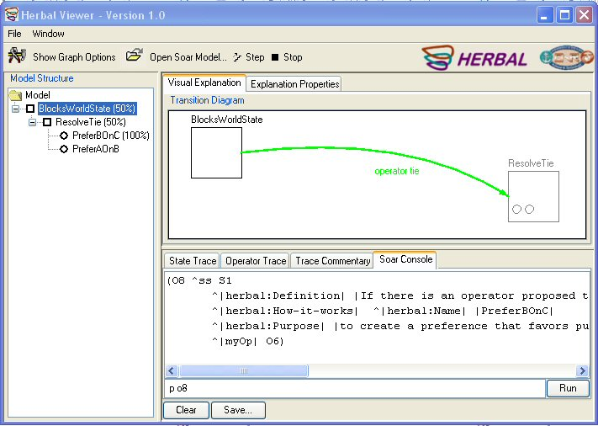
Herbal Viewer and Soar 8.6
The viewer can now send commands to Soar directly, thanks to Soar 8.6

Slide 10
Herbal: Users to Use, Test, Expand Herbal & dTank
IST 402: Models of human behaviour
(12+3, and 38+3 students)
BRIMS Tutorial (~25 tutees) (Cohen et al, 2005)
Use of dTank Microworld to understand, create, and exercise adversarial Soar models
Class projects
  MacSoar 8.5 compilation (see web site)
  Architectural comparisons (Sun et al, 2004)
  Example reuse curves (Morgan et al., 2005)
  Errors and Soar (Ritter et al., in prep.)
In general, the students encountered fewer problems programming in Soar when using Herbal

Slide 11
Herbal Users: (cont.)
4/9 of the final group projects used Herbal to create their final projects (all groups used Herbal in their homework).
2/4 Herbal teams had a model that ran, and 2/4 using plain Soar had a model that ran.
The most complex of the working models was an Herbal model that contained 16 pages of rules with 25 operators (>50 rules).
All projects used Herbal’s facility to include a header in their code that hooked up the models to dTank as they loaded.
Students noted Herbal’s ability to reuse conditions and actions across operators. Students also commented on the usefulness of Herbal’s ability to automatically generate comments.
During the course, students noted that Herbal did not support impasses, as one of the major disadvantages. Impasses added in v. 0.9.
The other disadvantages noted by students were related to usability issues with Protégé. A new Protégé version (version 3.0) addresses many of these issues.

Slide 12
Why Will Herbal Work?
Principled design based on a theory of knowledge (PSCM, roughly and extended)
Based on theory of explanations
Based on data on explanations study
New payoff - explanations
Software engineering principles
  Modularity
  Software reuse
  Design patterns
No lost expressiveness (almost)
Extendable by users / Common tools
User base used for feedback (~12+2+36+30)
Designed for usability by CS/HCI/Psy/IS team

Slide 13
Herbal’s Golden Nuggets
Eases maintainability
Accelerates programming
  3x Productivity (Yost with TAQL, 3 min./production)
  1x Productivity (IST 402 class, no complaints of Soar)
  1x-2x (Kukreja, first two programs @ 10 hours/prog.)
  3x productivity (Morgan et al., 2005)
Promotes reuse (document and import models), Operators and elaborations can share conditions and actions; states can share operators, elaborations, and impasses (Morgan et al. 2005)
Explanations may increase learning and use (not mentioned by our subjects)
Ver. 1.0 (14/6/05) includes changes suggested at BRIMS and ONR (save before compile, ability to include code in generated code, explanations in the viewer, contrast classes, a Soar console interface built directly into the viewer, etc).

Slide 14
Lumps of Coal
Hand-code Action and Condition expressions in Herbal
No Working Memory Browser in Herbal Viewer
Does not compile to other architectures, yet

Slide 15
Summary (mostly Gold)
High level compiler for Soar, designed for other architectures
Code reuse support
Example meta-architecture
Future
More explanations
More example models

Slide 16
References ( acs.ist.psu.edu/papers/)
Cohen, M. A., Ritter, F. E., & Haynes, S. R. (2005). Herbal: A high-level language and development environment for developing cognitive models in Soar. In Proceedings of the 14th Conference on Behavior Representation in Modeling and Simulation. 177-182. 05-BRIMS-044. Orlando, FL: U. of Central Florida.
Councill, I. G., Haynes, S. R., & Ritter, F. E. (2003). Explaining Soar: Analysis of existing tools and user information requirements. In Proceedings of the Fifth International Conference on Cognitive Modeling. 63-68. Bamberg, Germany: Universitats-Verlag Bamberg.
Haynes, S. R. (2001). Explanations in information systems: A design rationale approach. Unpublished Ph.D. dissertation, Departments of Information Systems and Social Psychology, London School of Economics.
Haynes, S. R., Councill, I. G., & Ritter, F. E. (2004). Responsibility-driven explanation engineering for cognitive models. In AAAI Workshop on Intelligent Agent Architectures: Combining the Strengths of Software Engineering and Cognitive Systems.
Morgan, G. P., Ritter, F. E., Stevenson, W. E., Schenck, I. N., & Cohen, M. A. (2005). dTank: An environment for architectural comparisons of competitive agents. In L. Allender & T. Kelley (Eds.), Proceedings of the 14th Conference on Behavior Representation in Modeling and Simulation. Orlando, FL: U. of Central Florida. 05-BRIMS-043.
Morgan, G. P., Haynes, S., Ritter, F. E., & Cohen, M. (2005). Increasing efficiency of the development of user models. In Proceedings of the 2005 Systems and Information Engineering Design Symposium. E. J. Bass, (ed). IEEE and Department of Systems and Information Engineering, University of Virginia: Charlottesville, VA.
Ritter, F. E. (2004). Choosing and getting started with a cognitive architecture to test and use human-machine interfaces. MMI-Interaktiv-Journal, 7, 17-37. useworld.net/mmiij/musimms.
Ritter, F. E., Baxter, G. D., Jones, G., & Young, R. M. (2000). Supporting cognitive models as users. ACM Transactions on Computer-Human Interaction, 7(2), 141-173.
Ritter, F. E., Shadbolt, N. R., Elliman, D., Young, R., Gobet, F., & Baxter, G. D. (2003). Techniques for modeling human performance in synthetic environments: A supplementary review. Wright-Patterson Air Force Base, OH: Human Systems Information Analysis Center. iac.dtic.mil/hsiac/S-docs/SOAR-Jun03.pdf
Amant, R., & Ritter, F. E. (2004). Automated GOMS to ACT-R model generation. In Proceedings of the International Conference on Cognitive Modeling. 26-31. Mahwah, NJ: Lawrence Erlbaum.
Sun, S., Councill, I., Fan, X., Ritter, F. E., & Yen, J. (2004). Comparing teamwork modeling in an empirical approach. In Proceedings of the Sixth International Conference on Cognitive Modeling. 388-389. Mahwah, NJ: Lawrence Erlbaum.
Notes:
If appropriate, include a VG listing publications that have come out of the project
Copies of all papers are available as noted on the web site.

